Slide 1
Apple Stock Price Prediction
P-213

Slide 2

Group-6
Group6
Mr. M Guru Bhavan Narayana
Ms. Ankita Patjoshi
MS. Gayathri P
Ms. Pawar Priya Rajendra
Mr. Uday Kiran D
Guide:
Ms. Neha Gupta

Slide 3
Business Objective
To Predict the Apple stock market price for next 30 Days.
There are Open, High, Low, Close, Adjusted Close and Volume (of stocks sold) has been given for each day starting from 2012 to 2019.
Objectives:
Split the last year into a test set- Can you build a Model for stock price?
Find Short Mid- and Long-term trends?
Understand how it is impacted from external factors or any other big external events.
Forecast for next 30 days?

Slide 4
Steps Followed:
1.: Collecting and preprocessing the data
used Yahoo Finance library
2. EDA for Stock price Analysis
EDA Summary
3. Splitting data for Training and Testing
4. Stock price Prediction Model Building
Different Models used & their Assumptions
5. Final Model Selection
LSTM
6. Evaluating the model
Metrics Used : MAPE, RMSE
7. Forecasting Next 30 days
Use the model to forecast future values of the Apple stock prices.

Slide 5
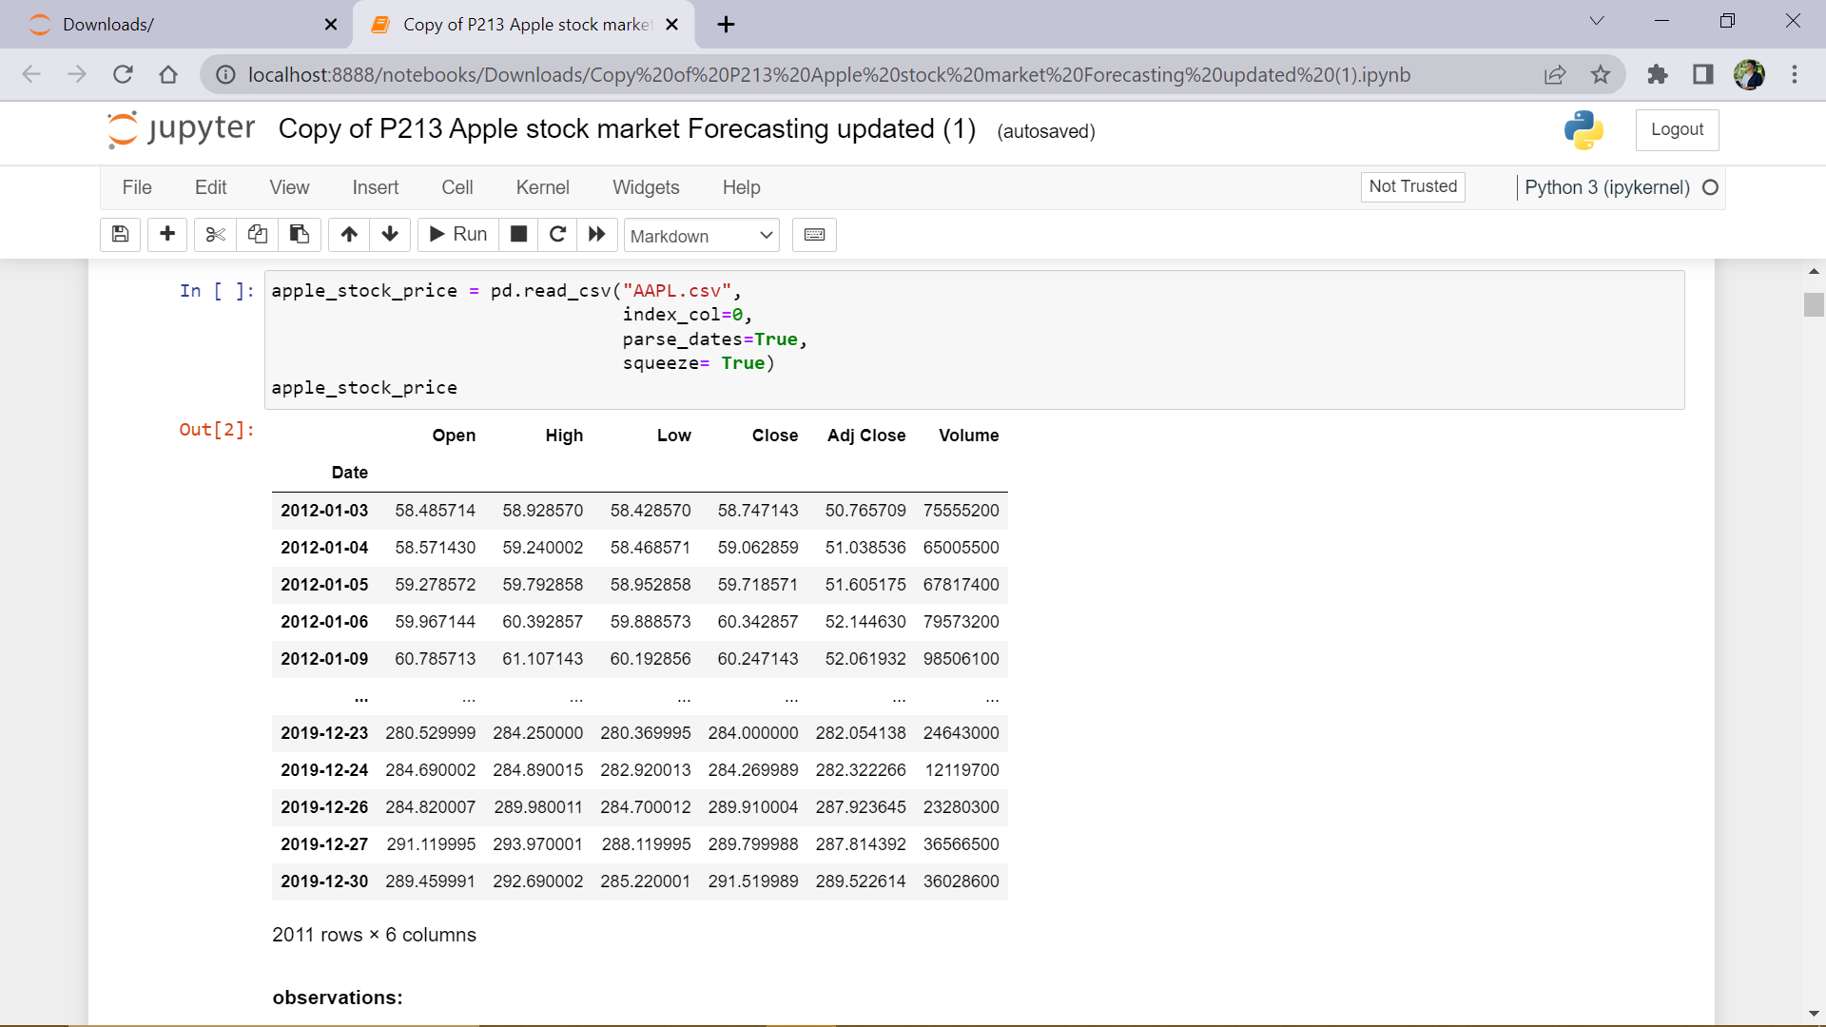
Apple-Stock Data (2012 – 2019)
Excel File : AAPL.csv :: C:\Users\HP\Documents\Data_Science_Project\P213- Apple-Stock-Forecasting\AAPL.csv

Slide 6
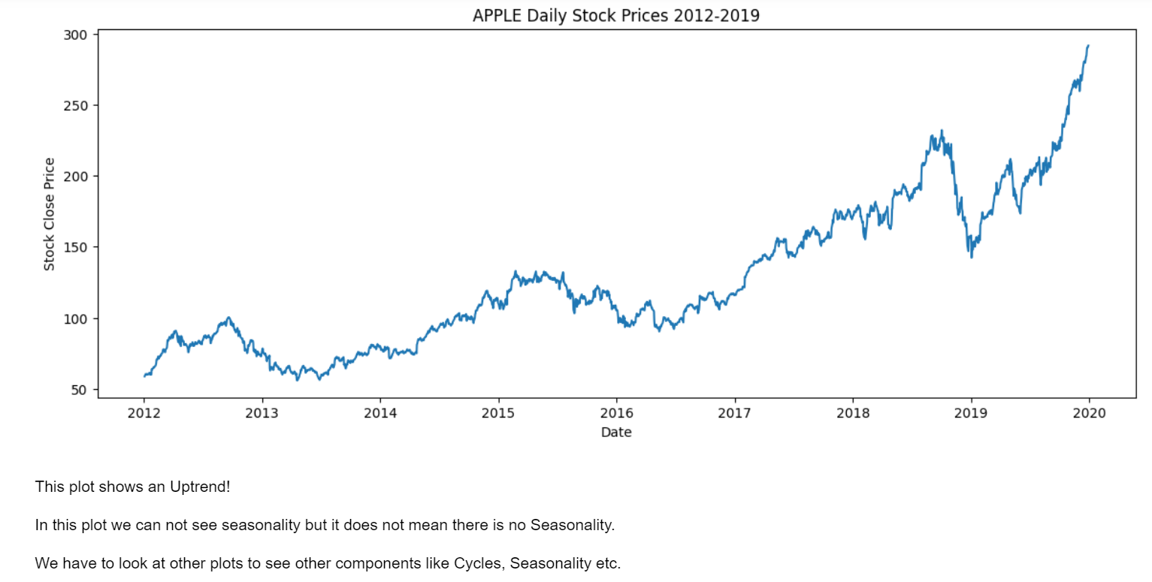
Line plot :

Slide 7
Summary
We can see that there are 2011 observations with 7 columns i.e., Date, Open, High, Low, Close, Adj.Close and Volume (of stocks traded).
We can see that there are missing values in the weekends and some other days.
Now we need to select our target column. In the problem statement it is clearly mentioned that we need to predict extra 30 days stock price, so we can not select volume column.
Adjusted close column is used for calculating Returns at any point of time. We can not use this for price prediction since adjusted close price involves dividends which are not constant over a period.
High and Low price cannot be chosen since we don't know at what time these values show up.
Compared to Open price, Close price is very important since open price has no prior data on that day so we can not see the moment of price on that day.
So, we can take "close price" as our target for forecasting

Slide 8
Important notes:
To make the web application realtime, we used yfinance library to render the live data.
We used 70% data for training and 30% for testing

Slide 9
Summary of EDA
We used Different visualizations to get insights
Data Checking:
No Null Values, No Missing Data
Data Understanding:
Line plot said, there is an UpTrend!
Histogram said, there is a Left skewnes implies slow upward moment of stock price overtime, and suggested Long term investments.
From month wise analysis, using boxplots , shows that high risk(volatility) associated with October month over the years. And it shows occurrence of high prices in November and December months, suggesting good stock selling time for stockholders.
From Quarter wise analysis, boxplots shows occurrence of high prices in 4th Quarter, and heatmap suggesting a Seasonality of 4 quarters.
From Year wise analysis, using Boxplots, shows an UpTrend with high Stocastic nature of stock price.

Slide 10
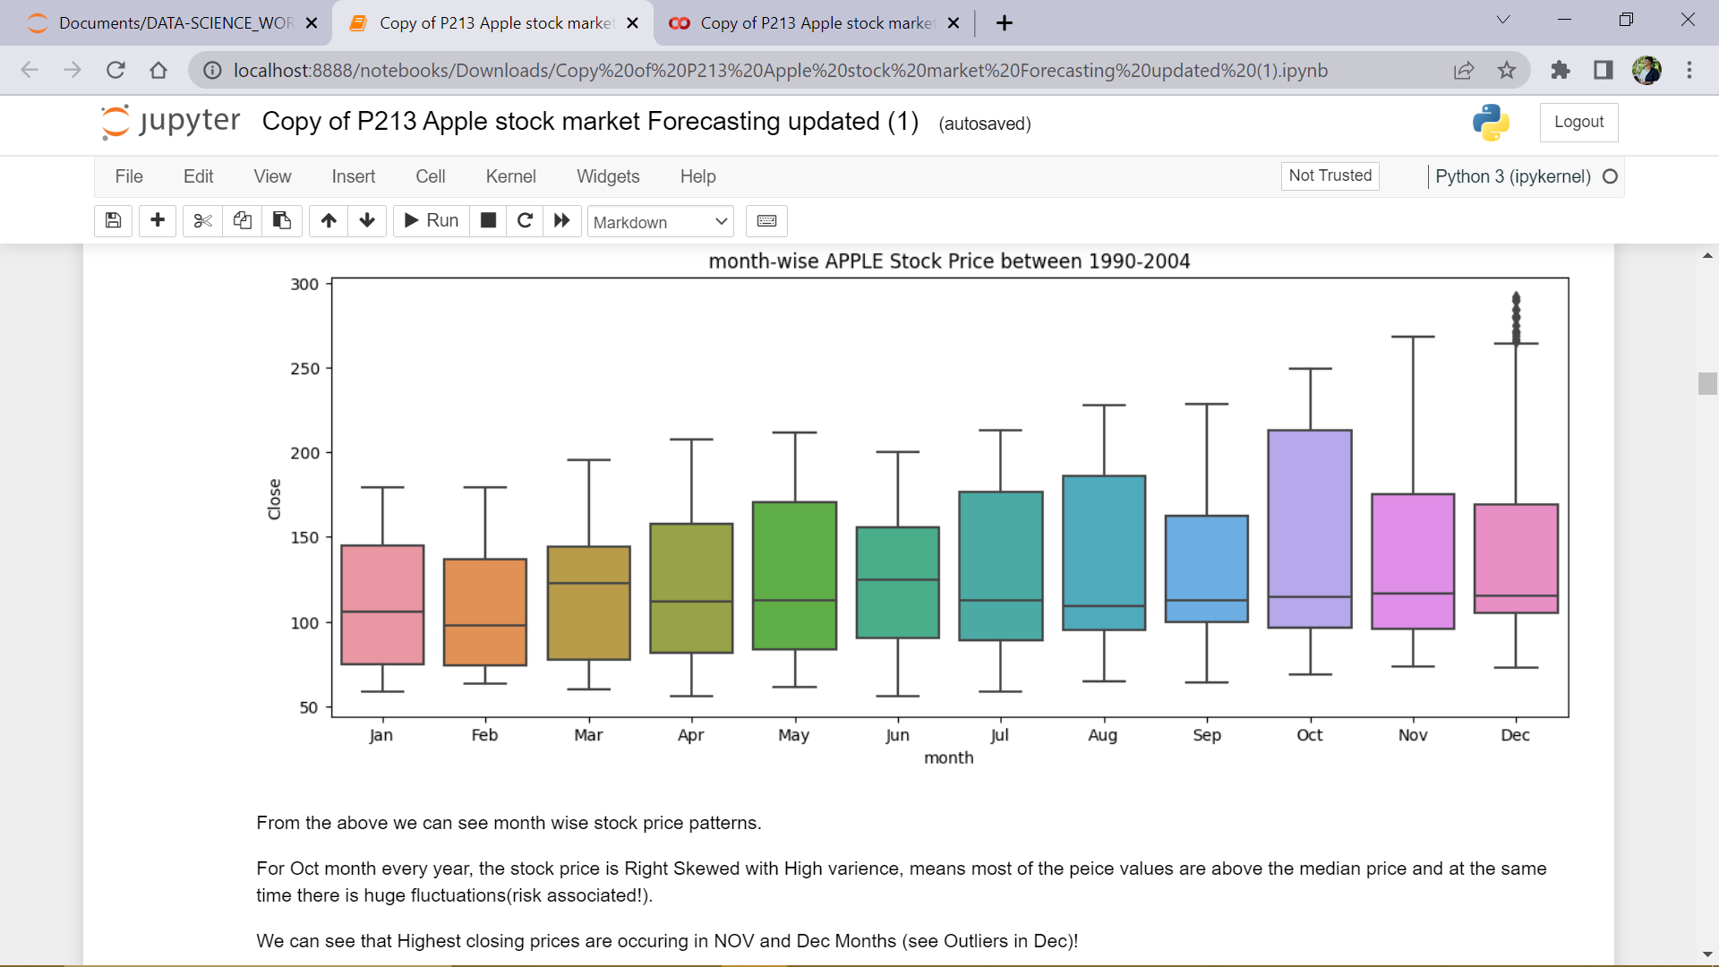
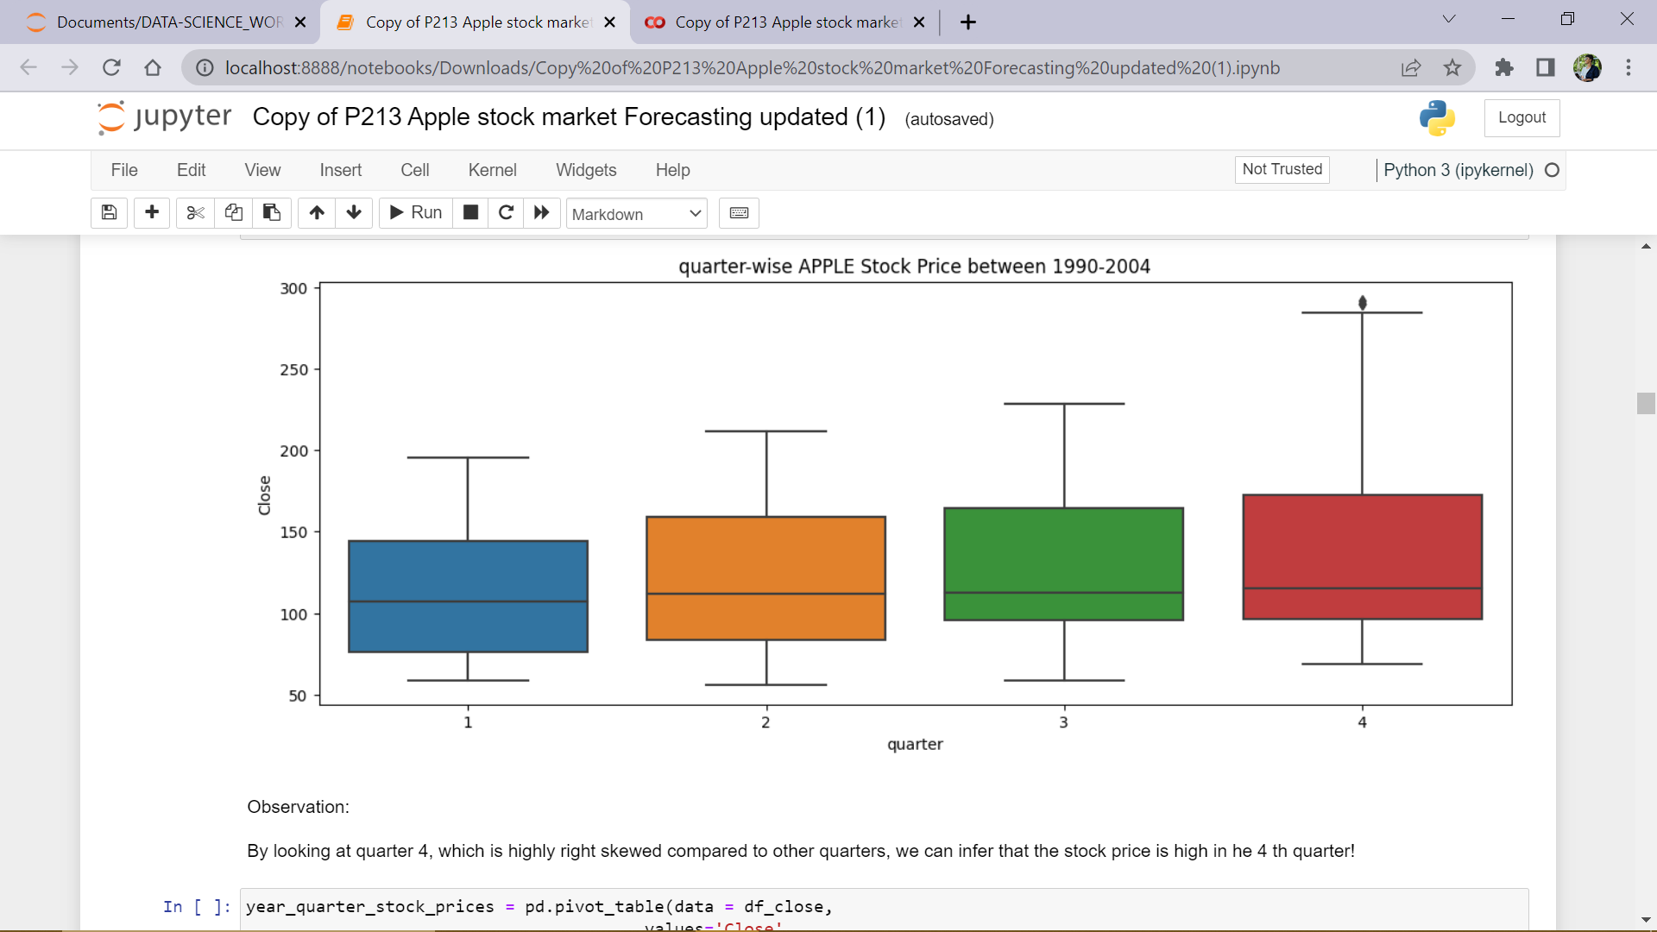

Slide 11
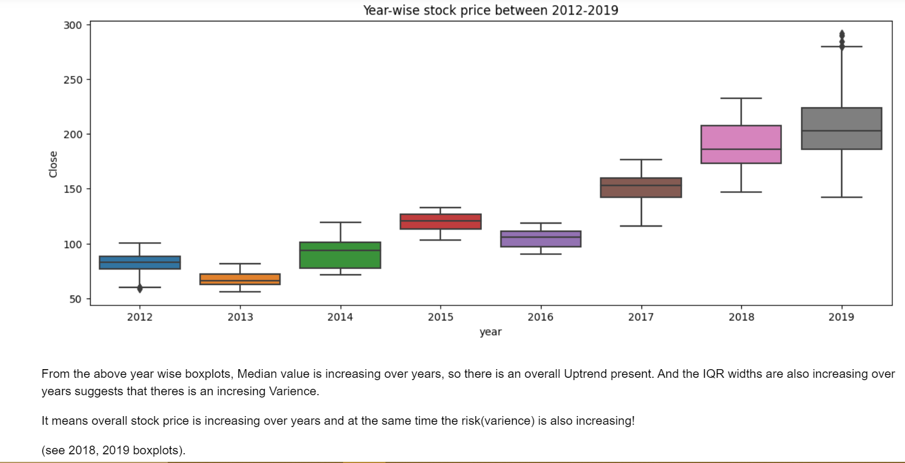

Slide 12
Summary of Time Series Analysis
Data is Non-Stationary!
From ADF test and AutoCorrelation plots…
First difference makes the Series Stationary. And PACF plots shows No Seasonality but suggests high stochastic nature of stock prices…
Seasonal_decompose method is giving a pseudo Seasonality but after analysing ACF and PACF we concluded there is no Seasonal order.

Slide 13
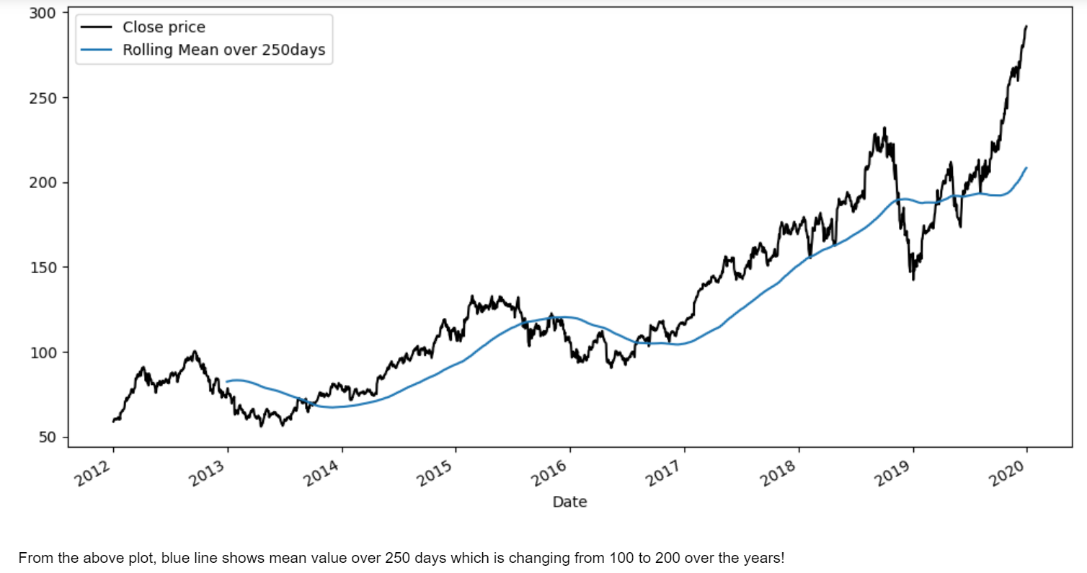
Stationarity Check

Slide 14
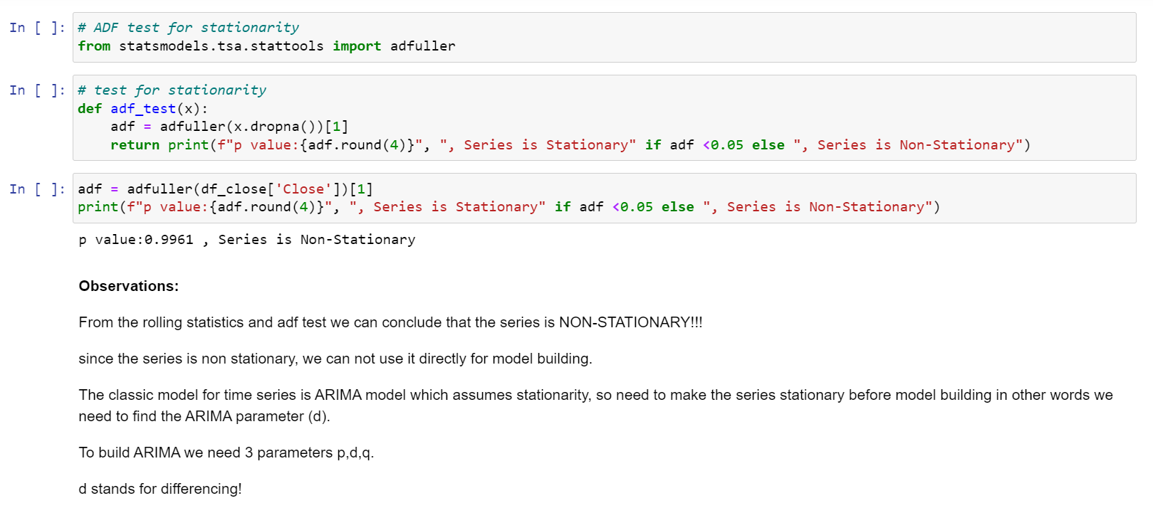
ADFULLER TEST

Slide 15
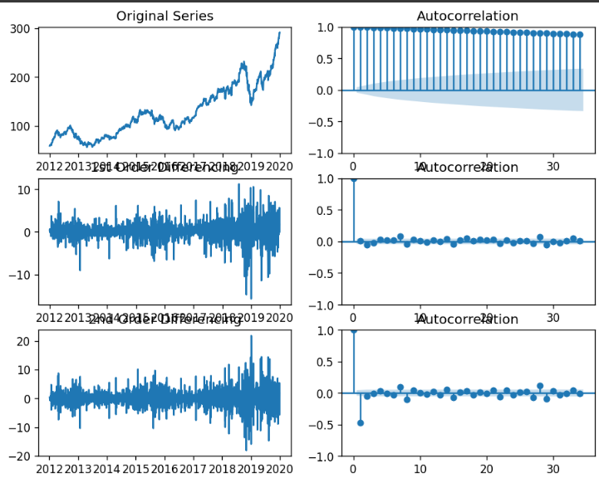
ACF plot for 1st differenced data

Slide 16
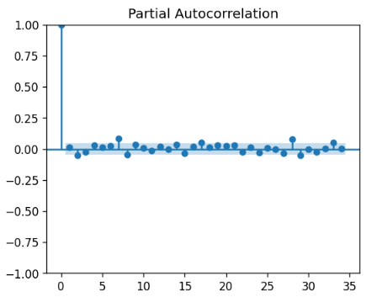
PACF plot for 1st differenced data

Slide 17
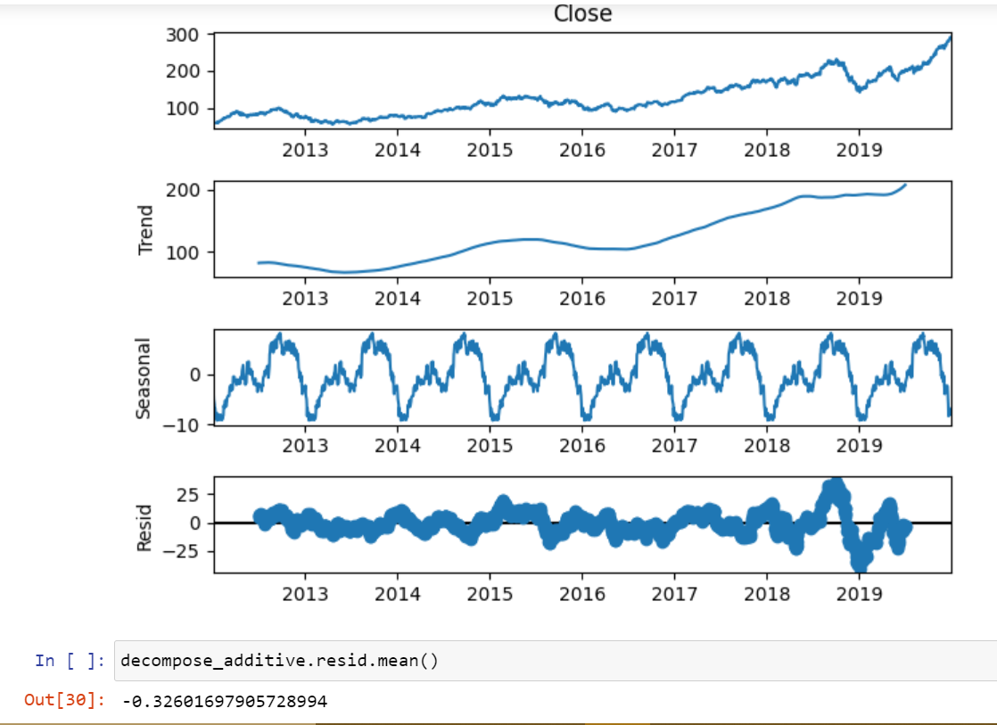
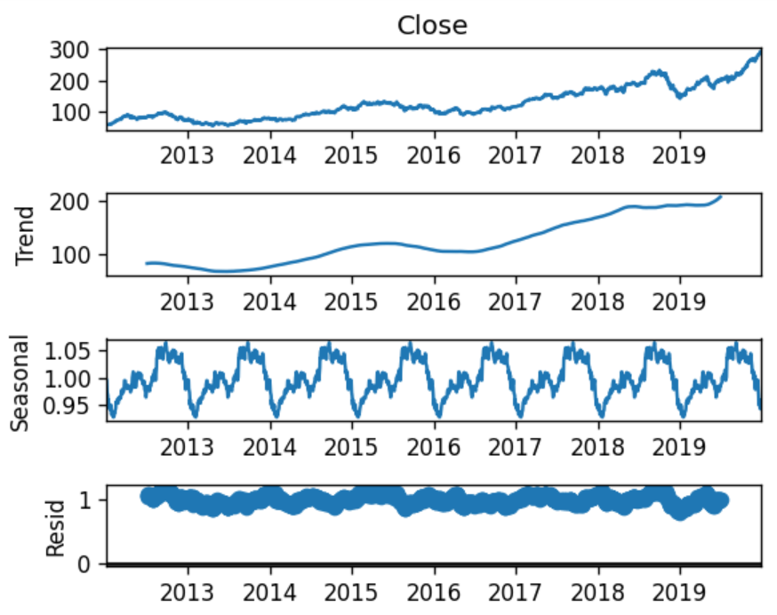
Decomposing Time-Series using Seasonal__Decompose
Additive Model
Multiplicative Model

Slide 18
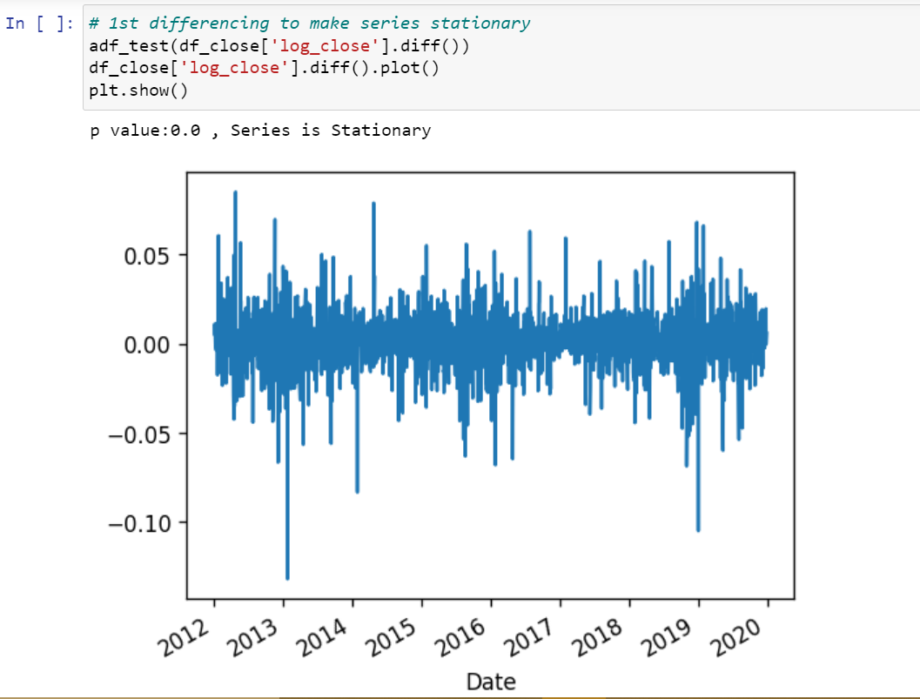
1st ORDER DIFFERENCING

Slide 19
Stock price prediction Models
Two kinds of Modeling for Stock price :
Past data does not influence the current data
Markov Models: Geometric Random Walk
Past data has some influence on Current data
Data Driven (ARIMA, Smoothing Methods and Deep Learning models)

Slide 20
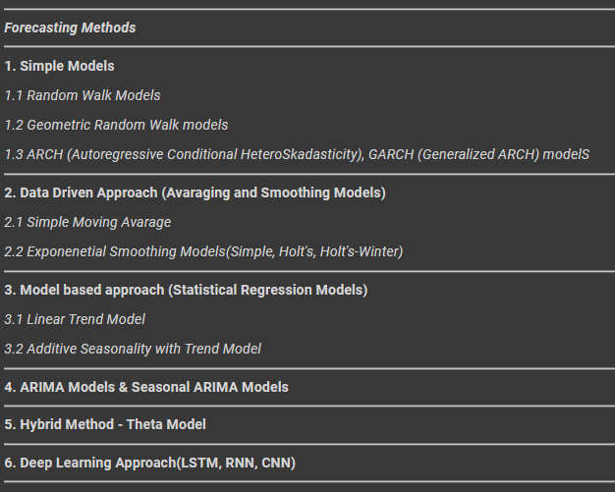

Slide 21
Final Model Selection
We Make Data Driven ARIMA model, which are not showing good results.
Smoothing Models like Holt’s Method is very sensitive to Smoothing parameters.
Theta model alos Not giving good result.
Geometric Random Walks are working well but needed some technical Understanding.
So finally we used DeepLearning LSTM(LongShortTermMemory) models to fit the data.
We Got Impresive results of MAPE <5%.
So we selected LSTM as our finel Model.

Slide 22
LSTM Results
test MAPE: 1.89
test RMSE: 5.01

Slide 23
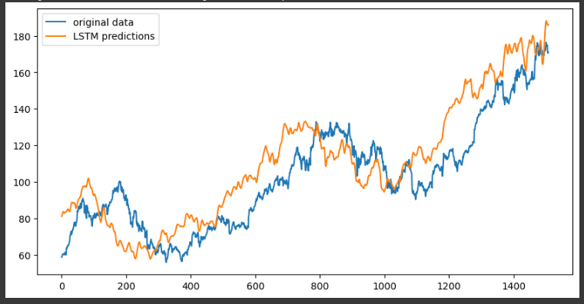
Predicted Vs Original Train data:

Slide 24
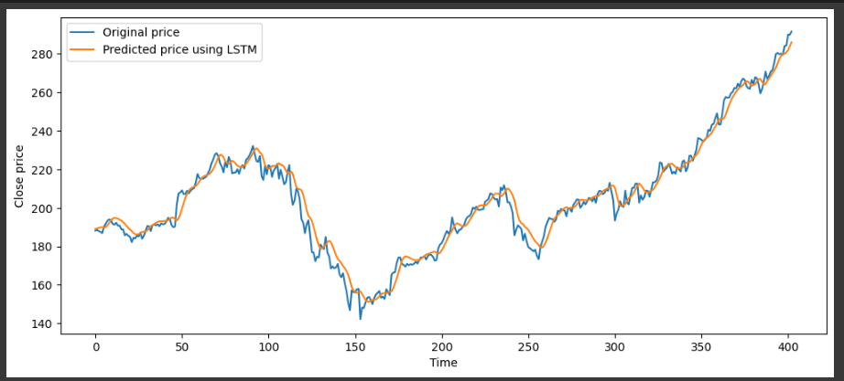
Predicted vs original on Test Data

Slide 25
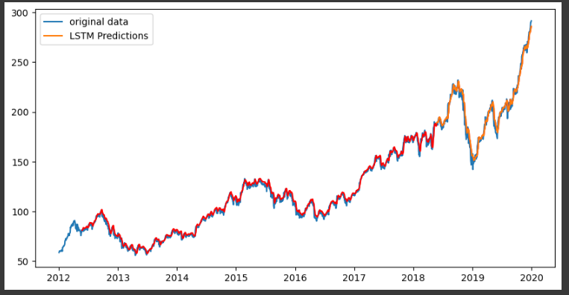
Predicted Vs Actual on Complete close price data:

Slide 26
Thank you

